Slide 1
Q and A
Q and A

Slide 2
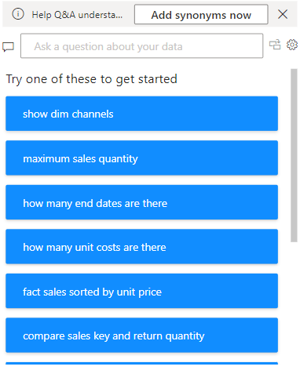
Q and A
Note: This lab is based on the excel file Sales.xlsx in Excel Sources
Add Synonyms Now
Purpose: Allows users to enhance Q&A performance by adding synonyms for field names or terms.
Why It’s Useful: If users use different terms to refer to the same field (e.g., "revenue" instead of "sales"), you can add these synonyms so Power BI understands the query.
Example: Add synonyms like "profit" for "net income" or "regions" for "territories."
Add a Q and A visual to the scene
Suggested Questions
Purpose: Power BI generates a list of predefined questions based on the dataset structure and metadata.
Why It’s Helpful:
Gives users ideas on what types of questions they can ask.
Encourages exploration of the dataset for insights.
Examples in Screenshot:
"Show dim channels": Likely returns a table of channel dimensions.
"Maximum sales quantity": Returns the highest sales quantity from the dataset.
Search Box
Purpose: Allows users to type a question in natural language about their dataset.
Example: You could type "What is the total sales?" or "Show sales by region.“
Power BI uses its AI capabilities to interpret the question and generate a visual (e.g., table, chart, or KPI) based on the dataset.

Slide 3
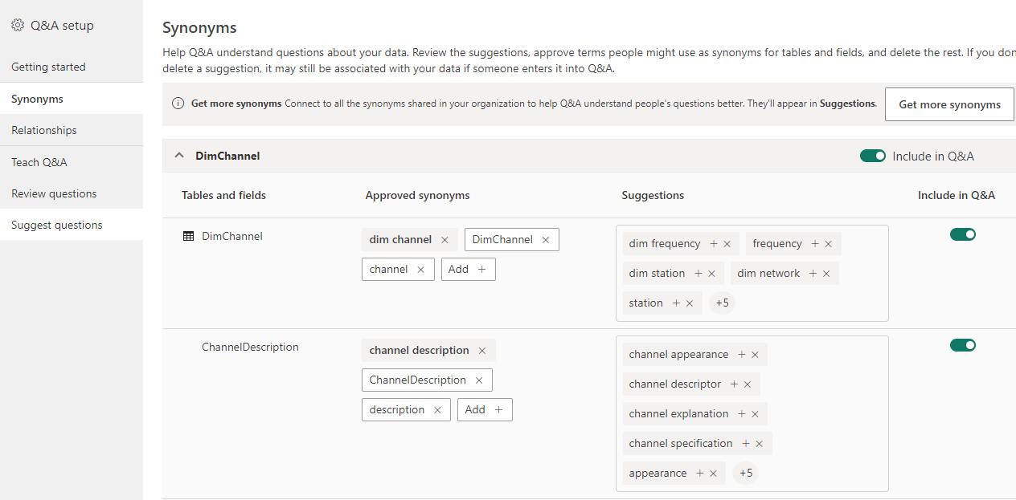
Q and A
The Add synonyms now leads to that configuration page to add like natural human language to build
more flexible expressions when composing questions

Slide 4
Q and A
The Add synonyms now leads to that configuration page to add like natural human language to build
more flexible expressions when composing questions
To show the global configuration dialog box
To convert the question into a visual

Slide 5
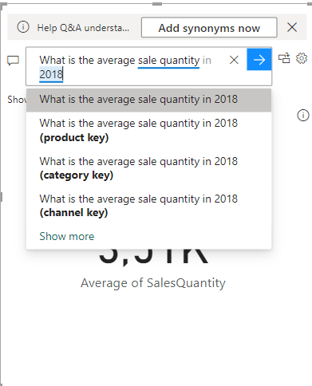
Q and A
Here is an example of using Q and A

Slide 6
Thank you
Thank you

